Slide 1

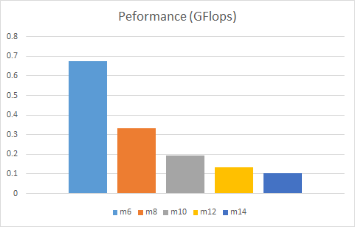
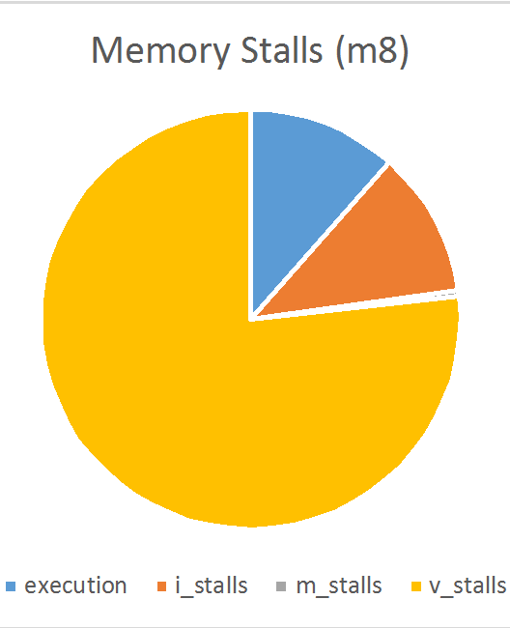
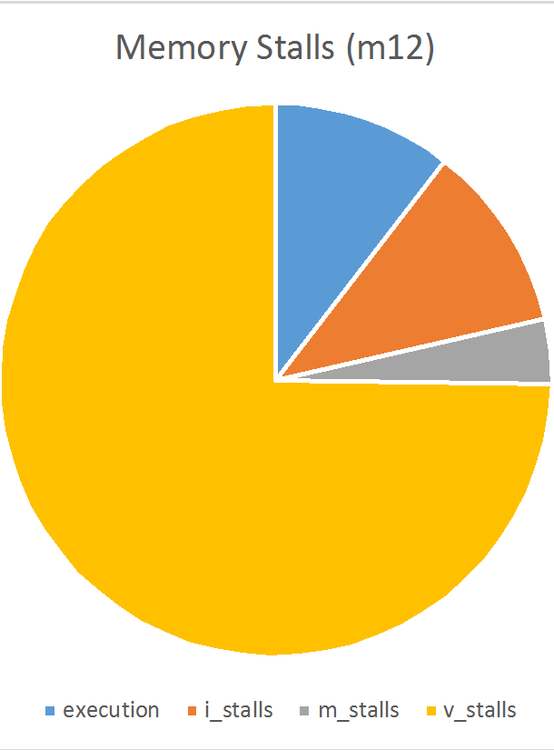
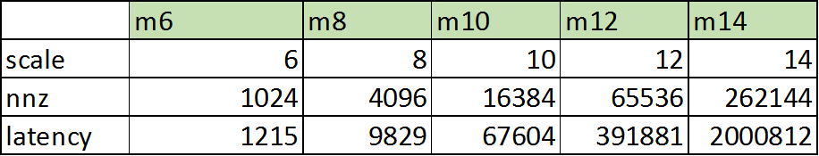
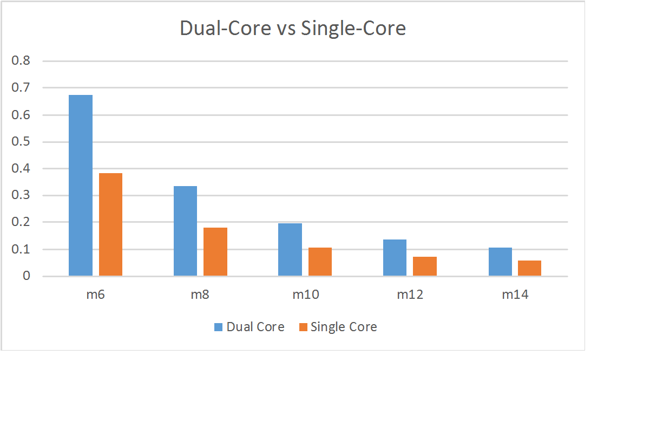
FlexGraph: A Reconfigurable Graph Analytics Accelerator for Heterogeneous CPU-FPGA Architectures
Blaise-Pascal Tine
Abstract
Architecture
Results
Type the abstract here. To remove bullet points, just click the Bullets button on the Home tab.
Background
Performance degrades with larger workloads!
Using Synthetic sparse matrices from Graph500 benchmark
Perf = 2 * nnz / latency
Where nnz = 16 * 2 ^ scale
Pick Memory B/W ~ 5GB/s
Pick Throughput ~
Objectives
Results
Conclusions

